Slide 1
MILESTONE 4
MedAssist AI
🏥AI-Powered Healthcare Assistance Platform
Testing, Deployment & Documentation — review for academic mentor
Milestone 4
Testing, Deployment & Documentation
Karumanchi Hemanth 10/09/2026
Infosys Springboard Internship

Slide 2
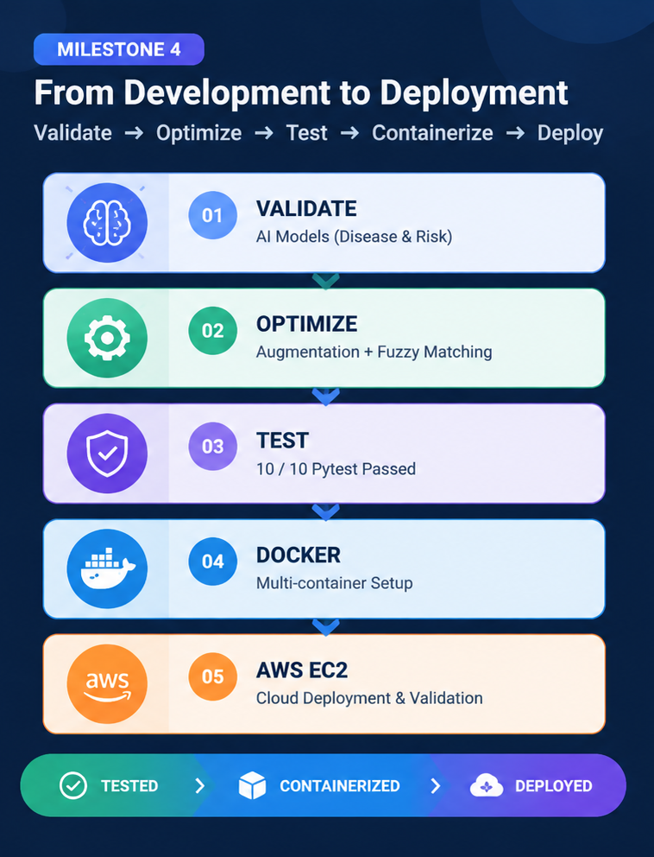
Milestone 4 Deliverables
Objective:
To validate and improve the MedAssist AI platform, optimize AI workflows, strengthen usability, perform automated testing, and deploy the complete application using Docker and AWS.
Key Activities:
AI model validation and optimization
Combinatoric symptom augmentation
Symptom typo/synonym resolution
UI readability and contrast improvements
Care Plans module enhancement
Automated testing using Pytest
Docker containerization
AWS EC2 deployment
MEDASSIST AI | INTERNSHIP REVIEW
01

Slide 3
AI Model Optimization & Validation
Disease Prediction Model
Random Forest Classifier
131 binary symptom features
41 disease classes
Combinatoric symptom augmentation
4,502 augmented training samples
Designed to improve robustness for partial symptom inputs
Patient Risk Model
8 patient health and demographic inputs
Random Forest-based classification pipeline
Accuracy: 92.16%
High-risk recall: 100% on evaluated test set
ROC-AUC: 97.69%
Validation Result
Metric | Result
Test Accuracy | 89.23%
Macro F1 Score | 89.33%
5-Fold CV Accuracy | 85.98% ± 0.51%
Prediction → Risk → Guidance
Disease prediction
MEDASSIST AI | MILESTONE 4
02

Slide 4
Robustness, Usability & Functional Enhancements
System Improvements
1. Symptom Input Robustness
  Added medical symptom alias dictionary
  Added fuzzy string matching using Python
  Improves symptom matching before prediction
2. UI Refinement
  Improved contrast and readability
  Refined interface elements for clearer user interaction
  Improved dashboard usability
3. Care Plans
  Added/enhanced Caretaker Care Plans
  Caretakers can create and manage patient care-plan information
Basic symptom input
More tolerant symptom input
Development UI
Improved readability
Patient monitoring
More tolerant symptom input
MEDASSIST AI | MILESTONE 4
03

Slide 5
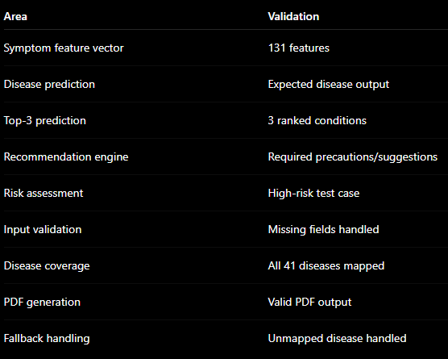
Testing & Quality Validation
Unit/Service Tests → API Validation → Model Validation
API Validation
Postman Collection
- Authentication
- AI prediction endpoints
- Patient records
- Caretaker modules
- System health
MEDASSIST AI | MILESTONE 4
04

Slide 6
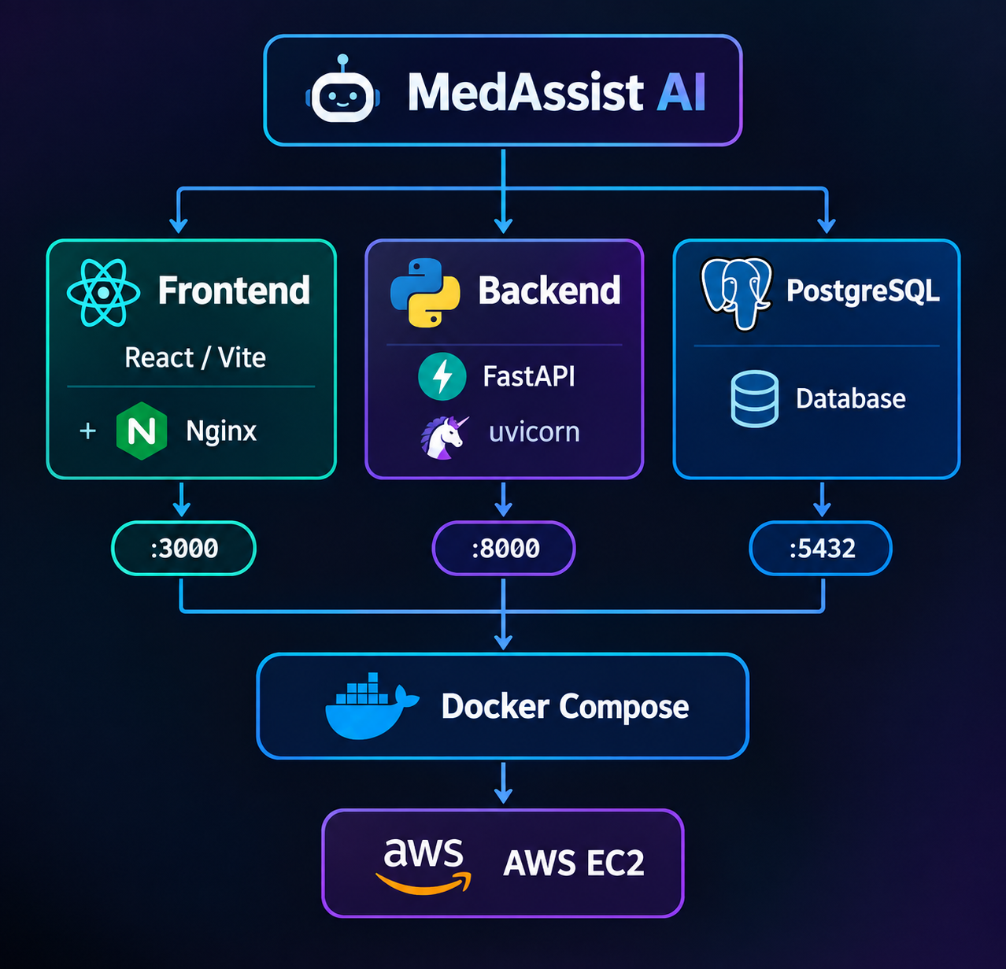
Dockerization, AWS Deployment & Final Outcome
Containerization & Cloud Deployment
Deployment
Dockerized frontend
Dockerized FastAPI backend
PostgreSQL container with persistent volume
Docker Compose for multi-container orchestration
Deployed on AWS EC2
End-to-end application validation performed in the cloud environment
The report describes the three-container Docker architecture and AWS EC2 deployment, and explicitly frames the deployment as demonstration/end-to-end validation rather than claiming production clinical deployment.
MEDASSIST AI | MILESTONE 4
05

Slide 7
